Slide 1

WEB BUILDING
‹#›
Cairo University Faculty of Engineering Computer Engineering Department
CMPN425-Fall 2022

Slide 2
PHP MYSQL
‹#›
CMPN425-Fall 2022

Slide 3
MYSQL
‹#›
The most popular open-source database system.
The data is stored in database objects called tables.
A table is a collections of related data entries and it consists of columns and rows.
Databases are useful when storing information categorically.
A company may have a database with the following tables: "Employees", "Products", "Customers" and "Orders".
CMPN425-Fall 2022
Notes:
‹#›

Slide 4

Tables
‹#›
A database most often contains one or more tables.
Each table is identified by a name(e.g."Customers" or“ Orders")
Tables contain records (rows) with data.
An example of a table called "Persons":
CMPN425-Fall 2022
Notes:
‹#›

Slide 5

Queries
‹#›
A query is a question or a request.
With MySQL, we can query a database for specific information and have a recordset returned.
Ex.: SELECT LastName FROM Persons
This query selects all the data in the "LastName" column from the "Persons" table, and will return a record set like this:
CMPN425-Fall 2022
Notes:
‹#›

Slide 6
Create a Connection to a MySQL Database
‹#›
First, you must create a connection to the database.
This is done with the mysql_connect() function.
mysql_connect(servername,username,password);
Or
mysqli_connect(servername,username,password);
CMPN425-Fall 2022
Notes:
To use MySQL with PHP and XAMPP:
1- Open XAMPP control panel and start Apache (like in the previous section)
2- Start MySQL
3- Go to http://localhost/phpmyadmin/ to see your databases and interact with them
$dbServername = "localhost";
$dbUsername = "root"; // default username for XAMPP MySQL
$dbPassword = ""; // default password for XAMPP MySQL
// Create connection
mysql_connect($dbServername, $dbUsername, $dbPassword);
‹#›

Slide 7
Example
‹#›
In the example we store the connection in a variable ($con) for later use in the script. The "die" part will be executed if the connection fails which will cause the script to terminate with the indicated message in the “die”.
<?php $con = mysql_connect("localhost",“admin",“pass123"); if (!$con) { die('Could not connect: ' . mysql_error()); } // some code
?>
CMPN425-Fall 2022
Notes:
If the connection is successful:
The variable $con will hold a resource link to the database connection that can be used for subsequent MySQL operations like querying the database.
This resource can then be used with other mysql_* functions to interact with the database, such as mysql_query(), mysql_select_db(), etc.
If the connection fails:
The function will return false, and an error related to the connection failure can be retrieved using mysql_error().
‹#›

Slide 8
Closing a Connection
‹#›
The connection will be closed automatically when the script ends.
To close the connection before, use the mysql_close() function:
<?php $con = mysql_connect("localhost",“admin",“pass123"); if (!$con) { die('Could not connect: ' . mysql_error()); } // some code mysql_close($con);
?>
CMPN425-Fall 2022
Notes:
‹#›

Slide 9
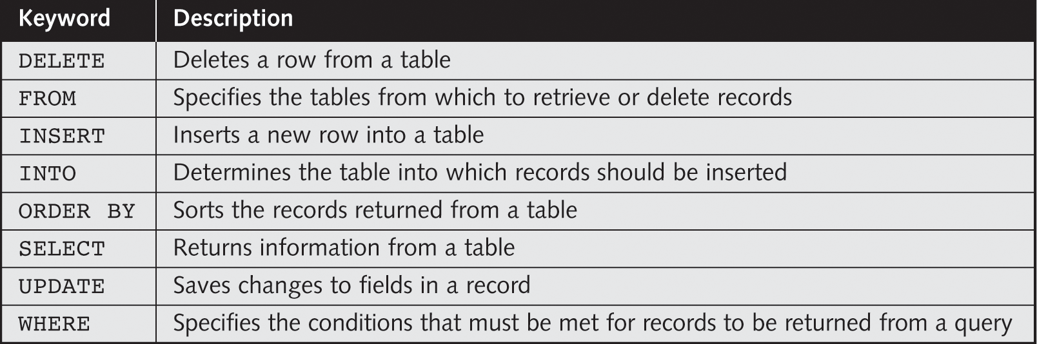
Querying Databases with Structured Query Language (SQL)
‹#›
Table 8-1 Common SQL keywords
CMPN425-Fall 2022
Notes:
DELETE FROM users WHERE id = 1;
SELECT * FROM products;
INSERT INTO customers (name, email) VALUES ('John Doe', 'john@example.com');
INSERT INTO employees (first_name, last_name) VALUES ('Jane', 'Doe');
SELECT * FROM orders ORDER BY order_date DESC;
SELECT name, age FROM users;
UPDATE products SET price = 19.99 WHERE id = 2;
SELECT * FROM employees WHERE department = 'Sales';
‹#›

Slide 10
Create a Database with SQL
‹#›
CREATE DATABASE database_name
to execute the statement above we must use the mysql_query() function. This function is used to send a query or command to a MySQL connection.
<?php $con = mysql_connect("localhost",“Admin",“pass123"); if (!$con) die('Could not connect: ' . mysql_error()); if (mysql_query("CREATE DATABASE my_db",$con)) echo "Database created"; else echo "Error creating database: " . mysql_error(); mysql_close($con); ?>
CMPN425-Fall 2022
Notes:
For SELECTstatements returning resultset, mysql_query() returns a resource on success, or false on error.
For other type of SQL statements, INSERT, UPDATE, DELETE, DROP, etc, mysql_query() returns true on success or false on error.
‹#›

Slide 11
Create a Table with SQL
‹#›
CREATE TABLE table_name ( column_name1 data_type, column_name2 data_type, column_name3 data_type, .... )
The following example creates a table named "Persons", with three columns. The column names will be "FirstName", "LastName" and "Age":
CMPN425-Fall 2022
Notes:
‹#›

Slide 12
Create a Table with SQL- Example
‹#›
A database must be selected before a table can be created. The database is selected with the mysql_select_db() function.
<?php $con = mysql_connect("localhost",“admin",“pass123"); if (!$con) { die('Could not connect: ' . mysql_error()); } // Create database if (mysql_query("CREATE DATABASE my_db",$con)) { echo "Database created"; } else { echo "Error creating database: " . mysql_error(); }
// Create table mysql_select_db("my_db", $con); $sql = "CREATE TABLE Persons ( FirstName varchar(15), LastName varchar(15), Age int )"; // Execute query mysql_query($sql,$con); mysql_close($con); ?>
CMPN425-Fall 2022
Notes:
‹#›

Slide 13
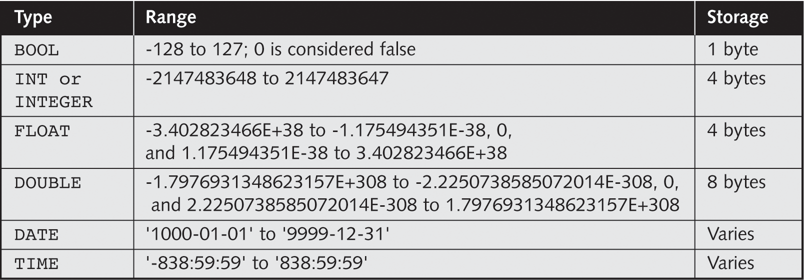
Specifying Field Data Types
‹#›
Table 8-3 Common MySQL data types
CMPN425-Fall 2022
Notes:
‹#›

Slide 14
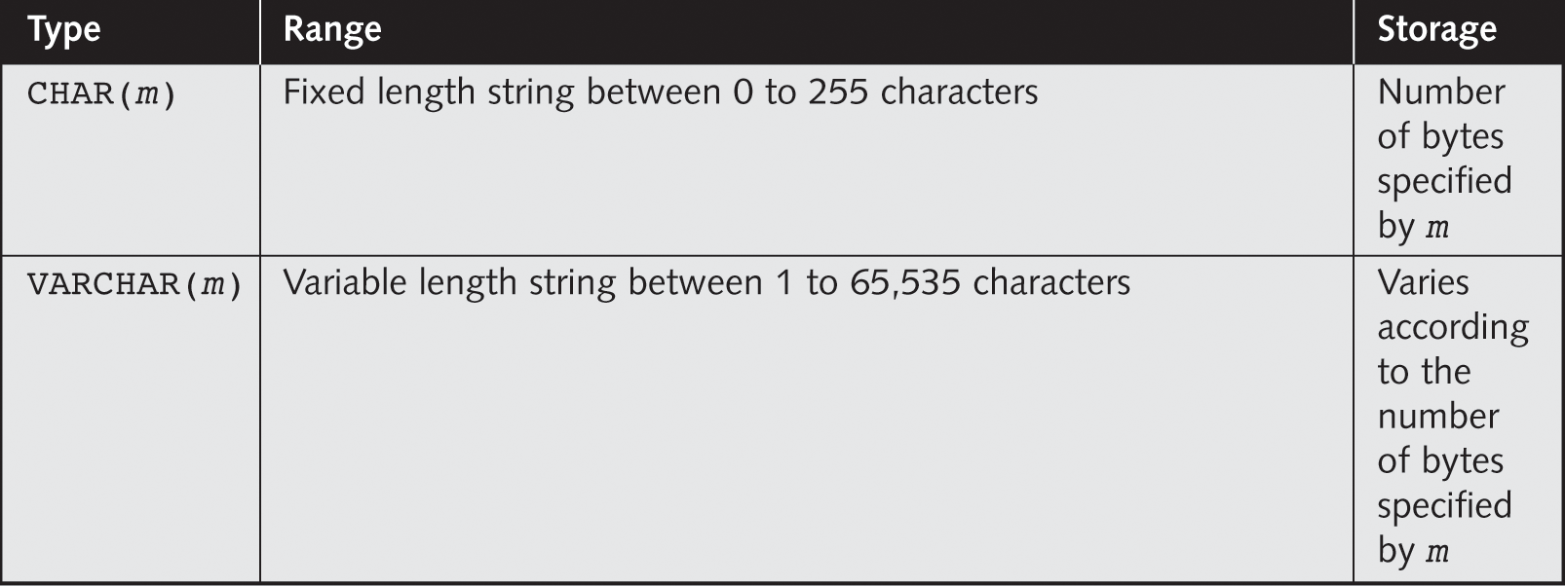
Specifying Field Data Types (continued)
‹#›
Table 8-3 Common MySQL data types (continued)
CMPN425-Fall 2022
Notes:
CHAR(m): is a fixed-length field, which means it always occupies m characters worth of storage, regardless of the actual length of the string. If the string you're storing is shorter than m characters, it will be padded with spaces to fill up the remaining space.
VARCHAR(m): is a variable-length field. It will only use as much storage as the string requires (plus some additional space to store the length of the string), up to a maximum of m characters. No padding is done, and thus no excess space is used if the string is shorter than m.
‹#›

Slide 15
Primary Keys and Auto Increment Fields
‹#›
Each table should have a primary key field.
A primary key is used to uniquely identify the rows in a table.
Each primary key value must be unique within the table.
The primary key field cannot be null because the database engine requires a value to locate the record.
The following example sets the personID field as the primary key field. The primary key field is often an ID number, and is often used with the AUTO_INCREMENT setting.
AUTO_INCREMENT automatically increases the value of the field by 1 each time a new record is added. To ensure that the primary key field cannot be null, we must add the NOT NULL setting to the field.
CMPN425-Fall 2022
Notes:
‹#›

Slide 16
Primary Keys and Auto Increment Fields
‹#›
$sql = "CREATE TABLE Persons ( personID int NOT NULL AUTO_INCREMENT, PRIMARY KEY(personID), FirstName varchar(15), LastName varchar(15), Age int )"; mysql_query($sql,$con);
CMPN425-Fall 2022
Notes:
‹#›

Slide 17
Select Data From a Database Table
‹#›
The SELECT statement is used to select data from a database.
SELECT column_name(s) FROM table_name
<?php $con = mysql_connect("localhost",“admin",“pass123"); if (!$con) die('Could not connect: ' . mysql_error()); mysql_select_db("my_db", $con); $result = mysql_query("SELECT * FROM Persons“); while($row = mysql_fetch_array($result)) { echo $row['FirstName'] . " " . $row['LastName']; echo "<br />"; } mysql_close($con);?>
Notes:
mysql_query() return true/false for queries that don’t return results such as insert, update, etc.
while loop will execute the mysql_fetch_array() function, assigning the resulting associative array to $row, and then executing the code within the loop block. On the next iteration, mysql_fetch_array() is called again to get the next row, and this process repeats until there are no more rows to fetch from the result set. At that point, mysql_fetch_array() returns FALSE, and the loop exits.
‹#›

Slide 18
Select Data From a Database Table
‹#›
This example stores the data returned by the mysql_query() function in the $result variable.
Next, we use the mysql_fetch_array() function to return the first row from the recordset as an array. Each call to mysql_fetch_array() returns the next row in the recordset.
The while loop loops through all the records in the recordset.
To print the value of each row, we use the PHP $row variable ($row['FirstName'] and $row['LastName']).
The output of the code above will be:
Peter Griffin Glenn Quagmire
CMPN425-Fall 2022
Notes:
‹#›

Slide 19
Select Data From a Database Table
‹#›
The following example selects the same data as the example above, but will display the data in an HTML table.
CMPN425-Fall 2022
Notes:
‹#›

Slide 20
Select Data From a Database Table
‹#›
<?php $con = mysql_connect("localhost",“admin",“pass123"); if (!$con) die('Could not connect: ' . mysql_error()); mysql_select_db("my_db", $con); $result = mysql_query("SELECT * FROM Persons"); echo "<table border='1'> <tr> <th>Firstname</th> <th>Lastname</th> </tr>"; while($row = mysql_fetch_array($result)) { echo "<tr>"; echo "<td>" . $row['FirstName'] . "</td>"; echo "<td>" . $row['LastName'] . "</td>"; echo "</tr>"; } echo "</table>"; mysql_close($con);?>
CMPN425-Fall 2017
Notes:
‹#›

Slide 21

Select Data From a Database Table
‹#›
The output of the code above will be:
CMPN425-Fall 2022
Notes:
‹#›

Slide 22
Select Data From a Database Table
‹#›
Where Clause is used to extract only those records that fulfill a specified criterion.
SELECT column_name(s) FROM table_name WHERE column_name operator value
CMPN425-Fall 2022
Notes:
‹#›

Slide 23
Select Data From a Database Table
‹#›
This example selects all rows from the "Persons" table where "FirstName='Peter':
<?php $con = mysql_connect("localhost",“admin",“pass123"); if (!$con) die('Could not connect: ' . mysql_error()); mysql_select_db("my_db", $con); $result = mysql_query("SELECT * FROM Persons WHERE FirstName='Peter'"); while($row = mysql_fetch_array($result)) { echo $row['FirstName'] . " " . $row['LastName']; echo "<br />"; }?>
Output:
Peter Griffin
CMPN425-Fall 2022
Notes:
‹#›

Slide 24
Select Data From a Database Table
‹#›
The ORDER BY keyword is used to sort the data in a recordset.
It sorts the records in ascending order by default.
If you want to sort the records in a descending order, you can use the DESC keyword.
SELECT column_name(s) FROM table_name ORDER BY column_name(s) ASC|DESC
CMPN425-Fall 2022
Notes:
SELECT FirstName, LastName
FROM Employees
ORDER BY LastName ASC, FirstName ASC
Default is ascending
The ORDER BY clause first sorts the data by LastName in ascending order.
If there are multiple employees with the same last name, the FirstName column is used as a secondary sort key, also in ascending order.
‹#›

Slide 25
Select Data From a Database Table
‹#›
<?php $con = mysql_connect("localhost",“admin",“pass123"); if (!$con) { die('Could not connect: ' . mysql_error()); } mysql_select_db("my_db", $con); $result = mysql_query("SELECT * FROM Persons ORDER BY age"); while($row = mysql_fetch_array($result)) { echo $row['FirstName']; echo " " . $row['LastName']; echo " " . $row['Age']; echo "<br />"; } mysql_close($con);?>
Output:
Glenn Quagmire 33
Peter Griffin 35
CMPN425-Fall 2022
Notes:
‹#›

Slide 26
Select Data From a Database Table
‹#›
It is also possible to order by more than one column. When ordering by more than one column, the second column is only used if the values in the first column are equal:
SELECT column_name(s) FROM table_name ORDER BY column1, column2
CMPN425-Fall 2022
Notes:
‹#›

Slide 27
Delete Data In a Database
‹#›
DELETE FROM table_name WHERE some_column = some_value
The WHERE clause specifies which record or records that should be deleted. If you omit the WHERE clause, all records will be deleted!
CMPN425-Fall 2022
Notes:
‹#›

Slide 28

Delete Data In a Database
‹#›
Person Table:
CMPN425-Fall 2022
Notes:
‹#›

Slide 29
Delete Data In a Database
‹#›
After the deletion, the table will look like this:
<?php $con = mysql_connect("localhost",“admin",“pass123"); if (!$con) { die('Could not connect: ' . mysql_error()); } mysql_select_db("my_db", $con); mysql_query("DELETE FROM Persons WHERE LastName='Griffin'"); mysql_close($con);
?>
CMPN425-Fall 2022
Notes:
‹#›

Slide 30
Insert Data Into the Database
‹#›
The INSERT INTO statement is used to add new records to a database table.
It is possible to write the INSERT INTO statement in two forms.
INSERT INTO table_name VALUES (value1, value2, value3,...)
INSERT INTO table_name (column1, column2, column3,...) VALUES (value1, value2, value3,...)
CMPN425-Fall 2022
Notes:
If you do not explicitly specify the column names into which the values should be inserted, you need to provide a list of values that corresponds directly to the columns in the table as they are defined in the database schema. The values must be provided in the exact order of the columns as they are defined in the table, and you must provide a value for every column in the table.
‹#›

Slide 31
Insert Data Into the Database
‹#›
<?php $con = mysql_connect("localhost",“admin",“pass123"); if (!$con) { die('Could not connect: ' . mysql_error()); } mysql_select_db("my_db", $con); mysql_query("INSERT INTO Persons (FirstName, LastName, Age) VALUES ('Peter', 'Griffin', '35')"); mysql_query("INSERT INTO Persons (FirstName, LastName, Age) VALUES ('Glenn', 'Quagmire', '33')"); mysql_close($con); ?>
CMPN425-Fall 2022
Notes:
‹#›

Slide 32
Update Data In a Database
‹#›
The UPDATE statement is used to update existing records in a table.
UPDATE table_name SET column1=value, column2=value2,... WHERE some_column=some_value
The WHERE clause specifies which record or records that should be updated. If you omit the WHERE clause, all records will be updated!
Persons table:
CMPN425-Fall 2022
Notes:
‹#›

Slide 33

Update Data In a Database
‹#›
<?php $con = mysql_connect("localhost",“admin",“pass123"); if (!$con) { die('Could not connect: ' . mysql_error()); } mysql_select_db("my_db", $con); mysql_query("UPDATE Persons SET Age = '36' WHERE FirstName = 'Peter' AND LastName = 'Griffin'"); mysql_close($con); ?>
Output:
CMPN425-Fall 2022
Notes:
UPDATE Persons SET Age = '36'
WHERE FirstName = 'Peter' OR LastName = 'Griffin';
In this case, the update will apply to rows where the first name is 'Peter' or the last name is 'Griffin', or both.
UPDATE Persons SET Age = '36'
WHERE FirstName = 'Peter' AND NOT LastName = 'Griffin';
Here, the update will apply to rows where the first name is 'Peter', but the last name is not 'Griffin'.
‹#›

Slide 34
Open Database Connectivity (ODBC)
‹#›
In normal case:
If you want your program to talk to an Access, FoxPro and Oracle databases you have to code your program with three different database API's.
with ODBC:
you only need to use the ODBC API (a combination of ODBC extension function calls and the SQL language) to talk to different database products. The ODBC Manager will figure out how to contend with the type of database you are targeting. Regardless of the database type you are using, all of your calls will be to the ODBC API.
All what you need to do is have installed an ODBC driver that is specific to the type of database you will be using.
Notes:
‹#›

Slide 35
Update Data In a Database
‹#›
<html> <body> <?php $conn=odbc_connect('northwind',‘admin',‘pass'); if (!$conn) {exit("Connection Failed: " . $conn);} $sql="SELECT * FROM customers"; $rs=odbc_exec($conn,$sql); if (!$rs) {exit("Error in SQL");} echo "<table><tr>"; echo "<th>Companyname</th>"; echo "<th>Contactname</th></tr>"; while (odbc_fetch_row($rs)) { $compname=odbc_result($rs,"CompanyName"); $conname=odbc_result($rs,"ContactName"); echo "<tr><td>$compname</td>"; echo "<td>$conname</td></tr>"; }
odbc_close($conn); echo "</table>"; ?> </body> </html>
DSN:Data source name-username -password
The odbc_fetch_row() function is used to return records from the result-set. This function returns true if it is able to return rows, otherwise false.
Notes:
‹#›

Slide 36

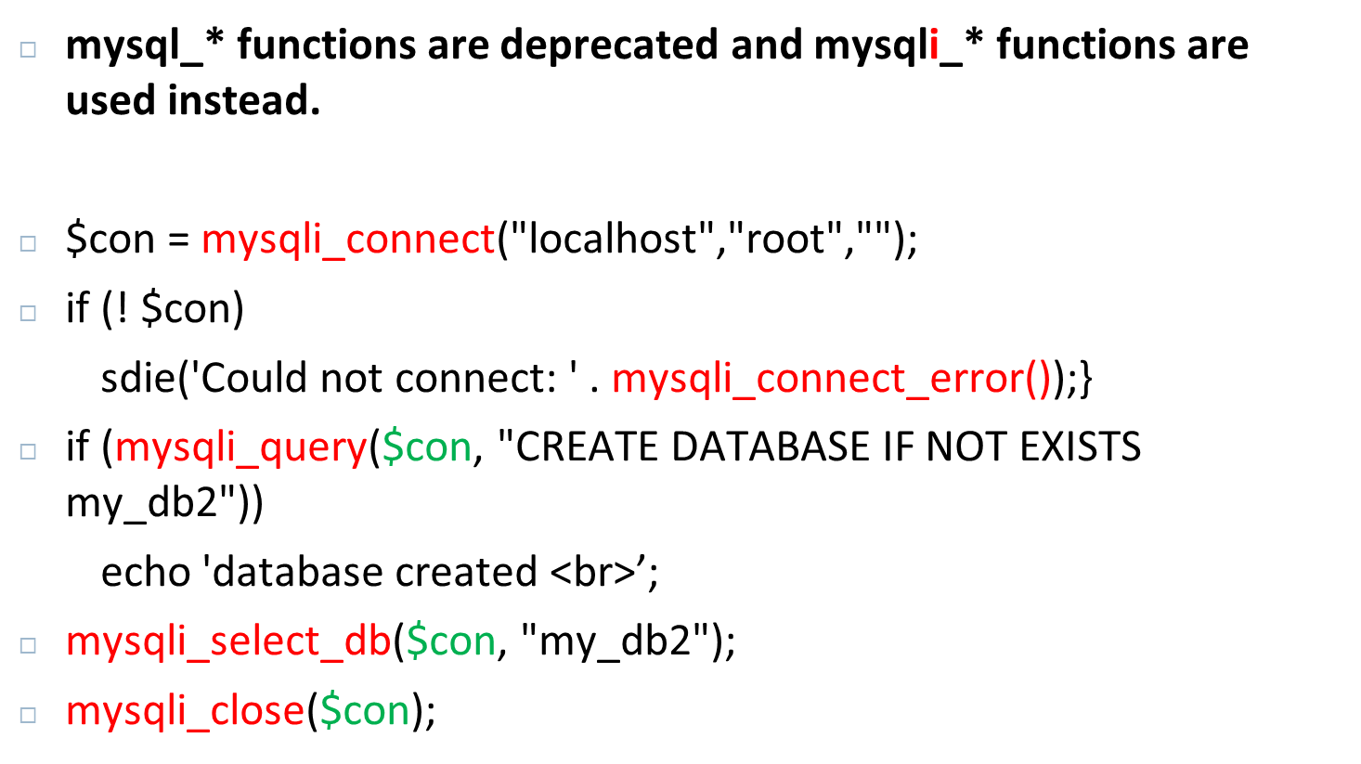

Slide 37
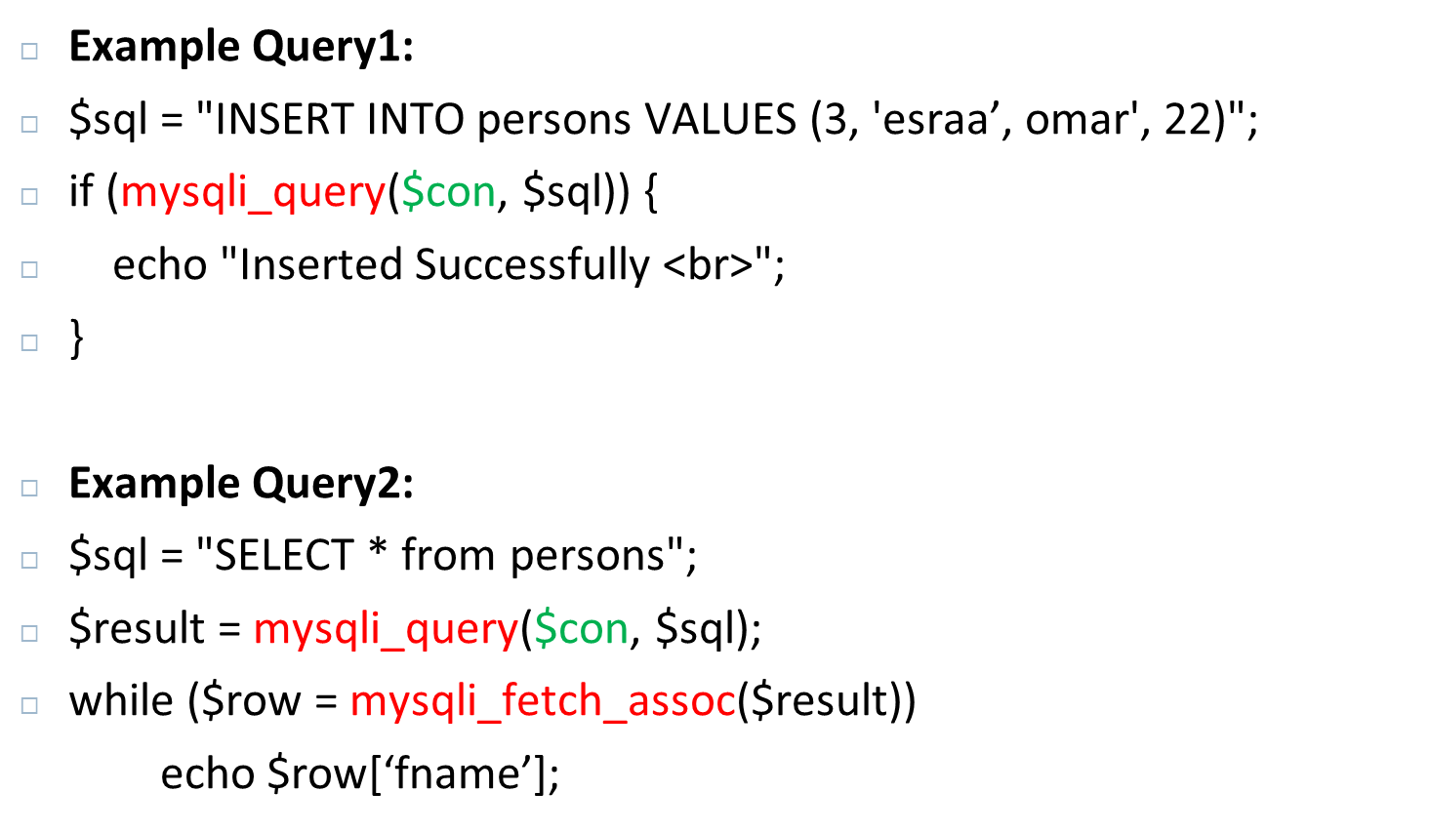
Notes:
Return Type:
mysql_fetch_assoc(): This function returns a row as an associative array. The keys of this array are the column names of the table in your database.
mysql_fetch_array(): This function can return a row as both an associative array and a numeric array. By default, it will return both unless specified otherwise by passing one of MYSQL_ASSOC, MYSQL_NUM, or MYSQL_BOTH as a second parameter.
Array Keys:
With mysql_fetch_assoc(), you can only access the data using the column names as keys.
With mysql_fetch_array(), you can access the data using either the column names or the column indices (numeric keys).
Usage:
Use mysql_fetch_assoc() when you want an associative array and you are referencing the fields by their names which can make the code more readable.
Use mysql_fetch_array() when you need an array indexed by both column names and zero-based column numbers. This can be useful if you have to access the columns numerically, but it can use more memory to store the additional index.

